Slide 1
GRE 单词训练营 #5
最好的方法 最高效的背 最地道的用
With Fiona

Slide 2
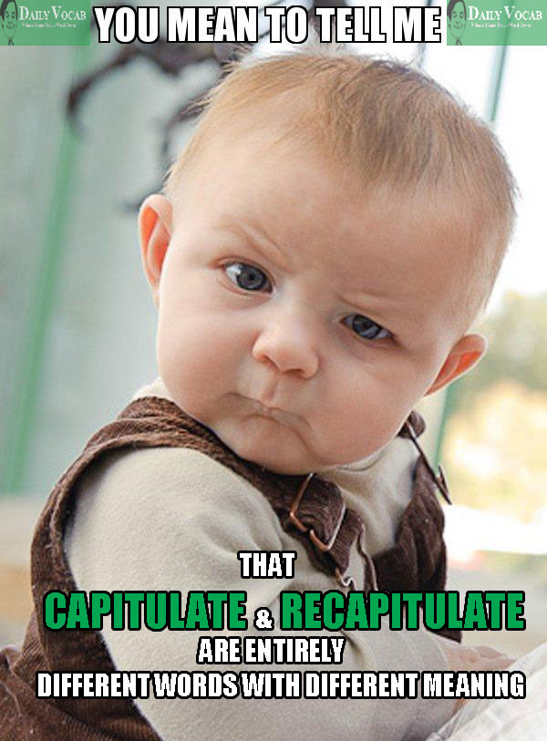
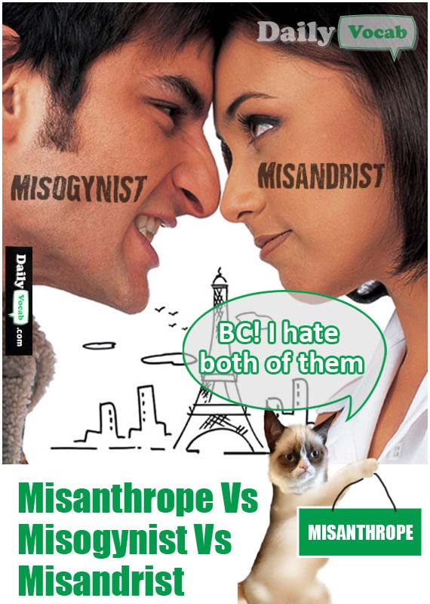
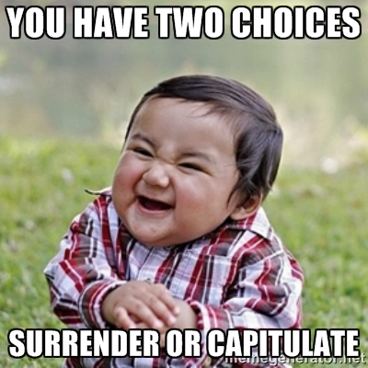

Slide 3
While most pets are relatively _____ in a veterinarian`s office, occasionally vets have to treat more aggressive animal patients.
A. fastidious
B. tractable
C. surreptitious
D. docile
E. clandestine
F. minuscule

Slide 4

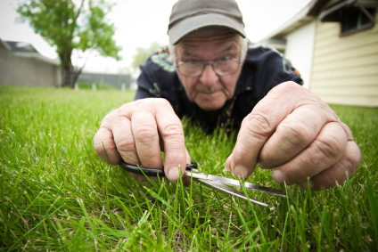
Review: fastidious
scrupulous
nitpicking
careful attention to detail
hard to please
Punctilious
assiduous
fussy
meticulous

Slide 5
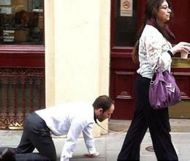
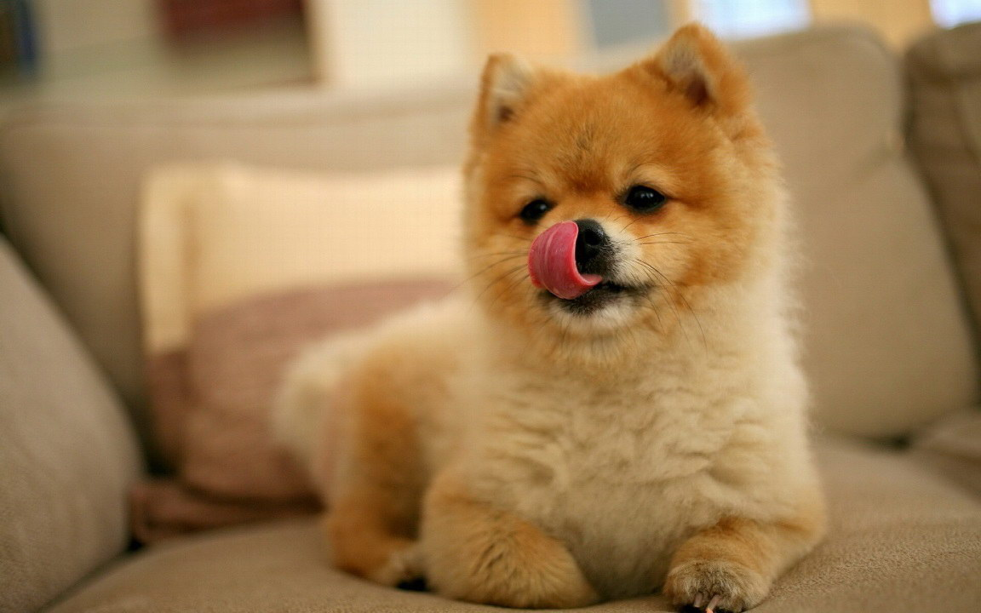
tractable
(of a person or animal) easy to control or influence:
our preschool teachers disagree with the statement that children are becoming less tractable every year
(of a situation or problem) easy to deal with
Tractable problem
Frequently tested with: amenable, complaisant, docile
obedient, submissive
Malleable, pliable,

Slide 6
Tame koala bears handled by tourists are _____, but wild koalas are hard to control and typically require two people to hold them.
A. amenable
B. gluttonous
C. supple
D. adroit
E. docile
F. mischievous

Slide 7
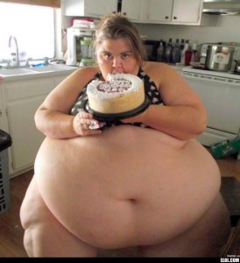
gluttonous
excessively greedy, especially when it comes to foods
Frequently tested with: greedy, voracious, insatiable(of an appetite or desire) impossible to satisfy

Slide 8
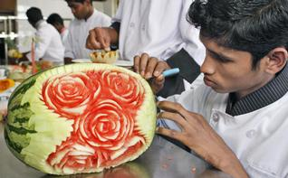
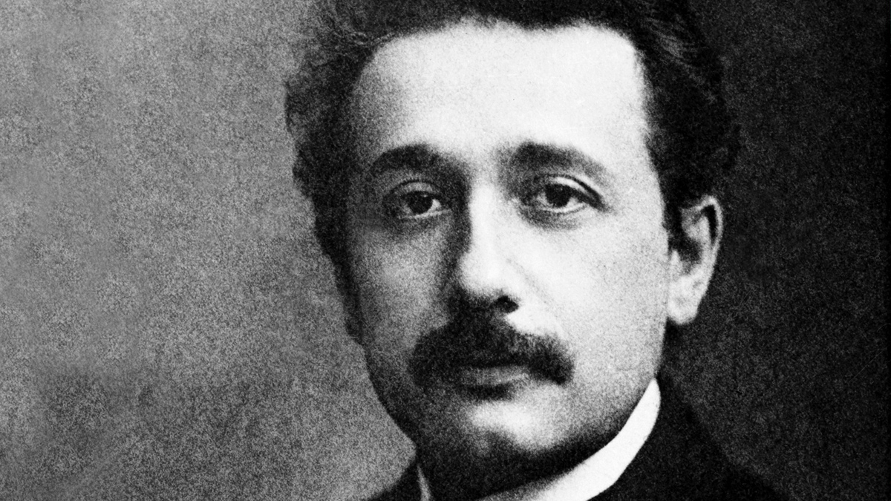
adroit
clever or skillful in using the hands or mind
an adroit politician
to be adroit at doing [something]
Frequently tested with:
Hands: adept, dexterous, deft, nimble
Mind: cunning, wily
astute, shrewd, canny

Slide 9
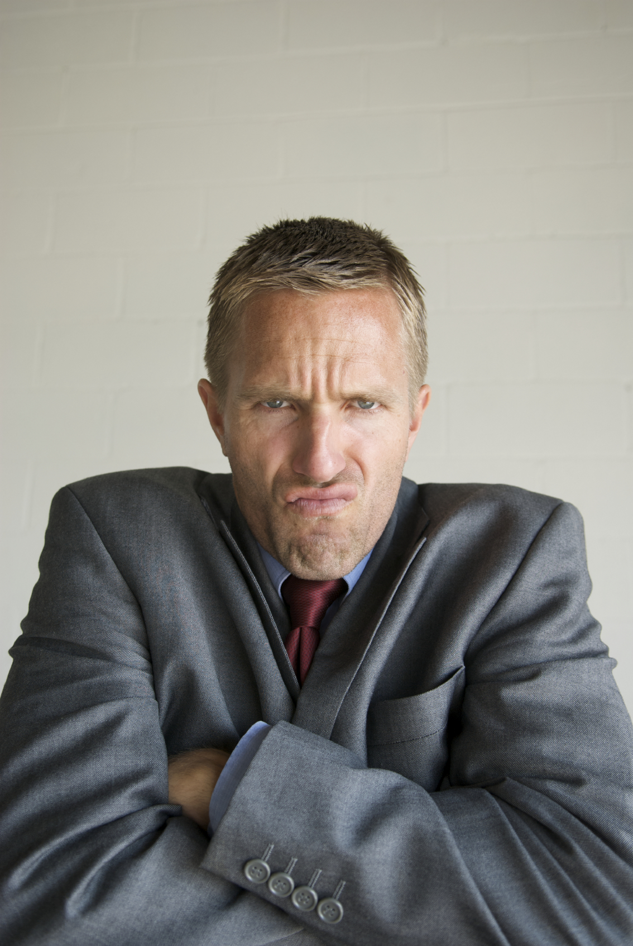


jaundiced
affected by bitterness, resentment, or envy:
they looked on politicians with a jaundiced eye.
Frequently tested with: resentful, cynical, disenchanted, suspicious, misanthropic

Slide 10
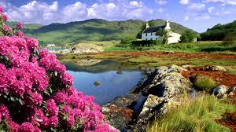
Idyllic
An idyllic place is a rural place that is quite, peaceful, picturesque, and attractive.
It is an idyllic little place, nestled in the Appalachian foothills, surrounded by horse farms and vineyards, with cheap, charming homes.
You can also say you live an idyllic lifestyle.
Frequently tested with: halcyon, bucolic

Slide 11
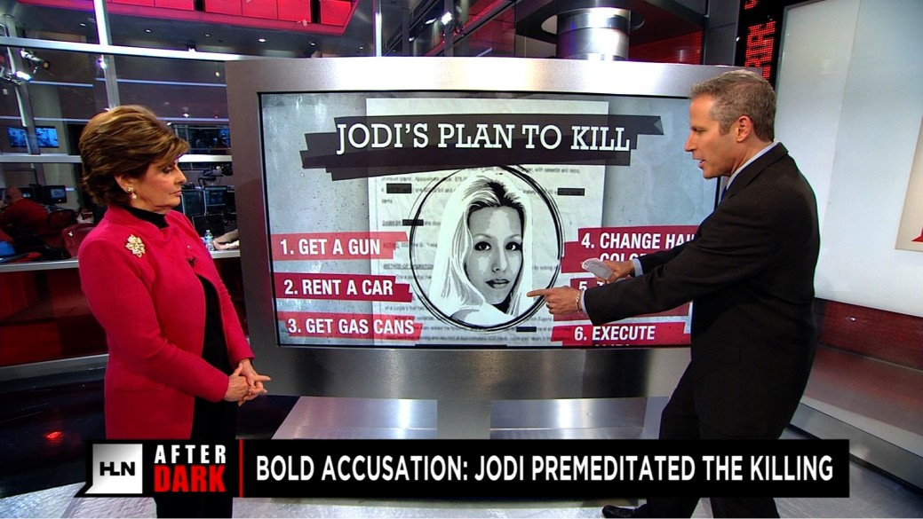
Calculated/ premeditated
A calculated action is one that is done with full awareness of the likely consequences
to take a calculated risk or gamble
Yale political scientist Jason Lyall says that the destruction of cultural heritage sites is a calculated political move by militants.
Frequently tested with: premeditated, preconceived

Slide 12
The corporation`s code of ethics is ludicrous; its principles are either ____, offering clichés in lieu of guidance, or so unspecific as to make any behavior ____.
A. platitudinous | D. unlikely
B. anonymous | E. portentous
C. instructive | F. permissible

Slide 13

Apocalyptic
describing or prophesying the complete destruction of the world: pertaining to revelations especially of disaster
The conflict between the two countries is reaching apocalyptic proportions.
Frequently tested with: ominous, portentous, catastrophic

Slide 14
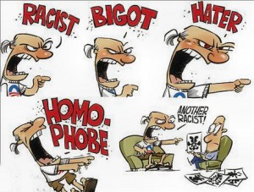
bigoted
having or revealing an obstinate belief in the superiority of one's own opinions and a prejudiced intolerance of the opinions of others
Bigot (n.)
a bigoted group of reactionaries
Frequently tested with: prejudiced, sectarian, opinionated, dogmatic
Chauvinistic, jingoistic

Slide 15
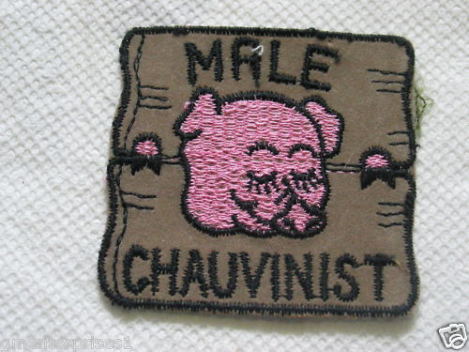

Chauvinistic/ jingoistic
Chauvinistic: feeling or displaying aggressive or exaggerated patriotism + displaying excessive or prejudiced support for their own cause, group, or sex.
Jingoistic: extreme patriotism, especially in the form of aggressive or warlike foreign policy.

Slide 16



Slide 17
Frequently tested GRE Words of 2015
tractable
fastidious
docile
acclaimed
clandestine
eminent
foresee
prosaic
surreptitious
illicit

Slide 18
Frequently tested GRE Words of 2015
chauvinistic
reactionary
calculated
portentous
idyllic
jaundiced
adroit
insatiable
apocalyptic
wily

